Slide 1
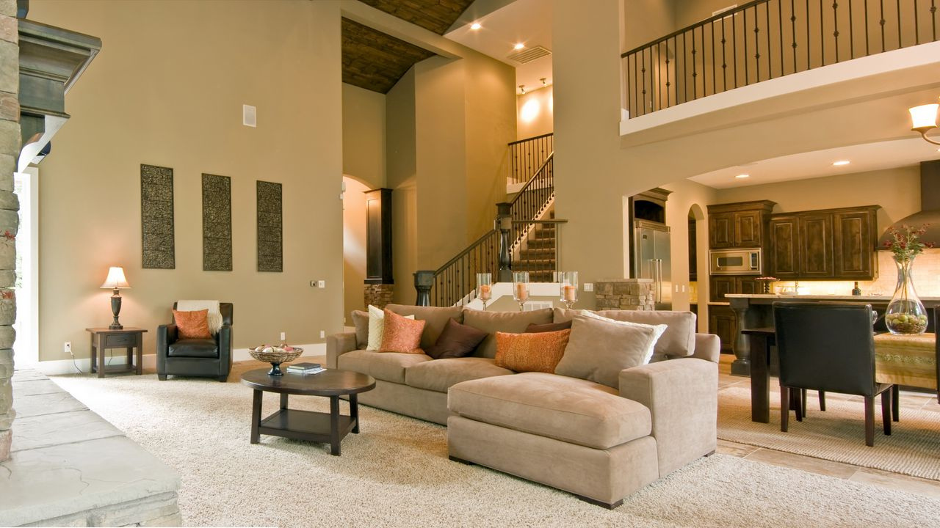
Modern House Pricing Predictor

Slide 2
Our predictive model uses advanced algorithms to estimate house prices based on location, size, amenities, and other factors. Let's explore it together!
Introduction to the Model

Slide 3

Data Collection and Analysis
Collect data on recent real estate sales, analyze market trends, and create visually appealing graphs and charts to help predict pricing in the housing market.

Slide 4
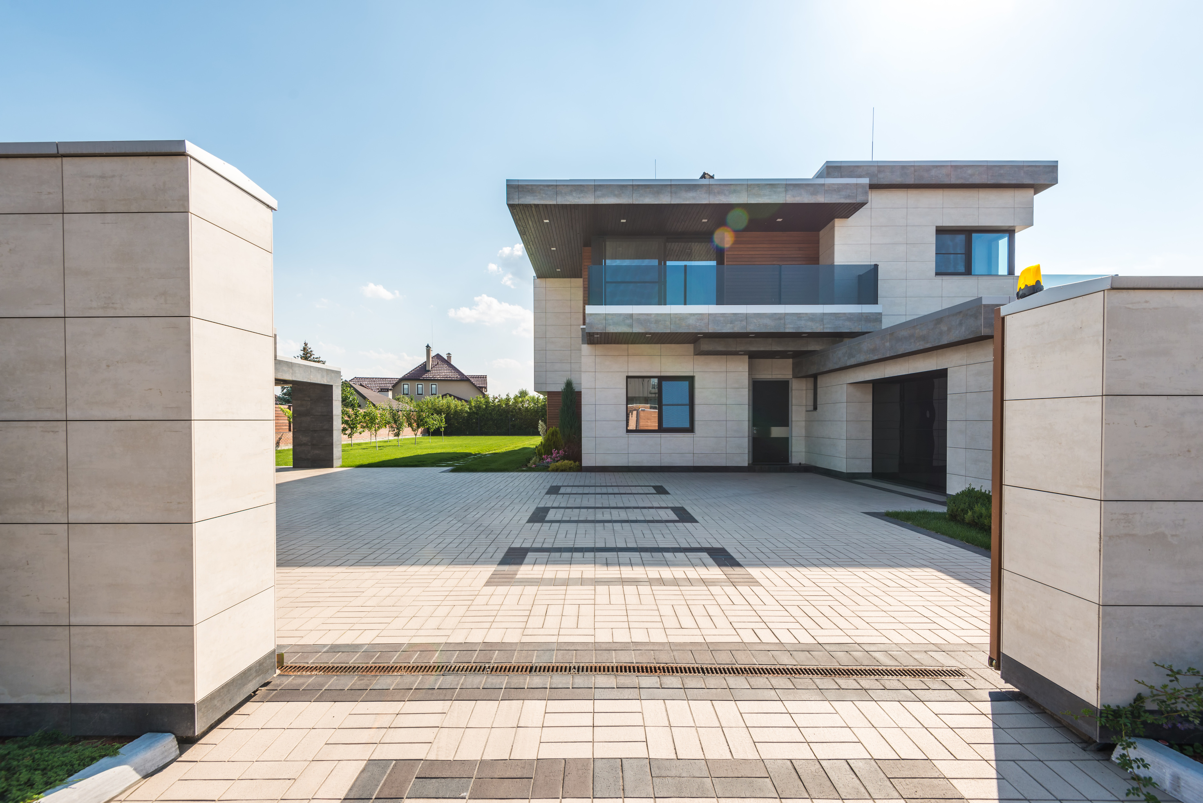
Features used in the model
Square footage of the house.
Number of bedrooms and bathrooms.
Location and neighborhood of the property.

Slide 5

Incorporate clean lines, minimalism, neutral color palettes, and sustainable materials to create a modern, eco-friendly home. Consider incorporating natural light and outdoor spaces for added appeal.
Model Architecture

Slide 6

Testing and Validation
Use design to visualize real estate trends and predict future pricing. Test and validate data to ensure accuracy in your predictions.

Slide 7

Results and Analysis
Housing prices have increased by X% over the past year.
The average price per square foot in the area is $X.
The market shows signs of continuing growth, with a predicted increase of X% in the next year.

Slide 8

As technology advances and cities grow, real estate will continue to be a valuable investment. Stay informed on market trends and predictions to make informed decisions.
Conclusion

Slide 9

Thank you for considering the future of real estate with us!

